Slide 1
Molecular Communication BT_S13
Dhruv Shah – AU1841030
Yash Patel – Au1841125
Priyank Sangani – AU1841136

Slide 2
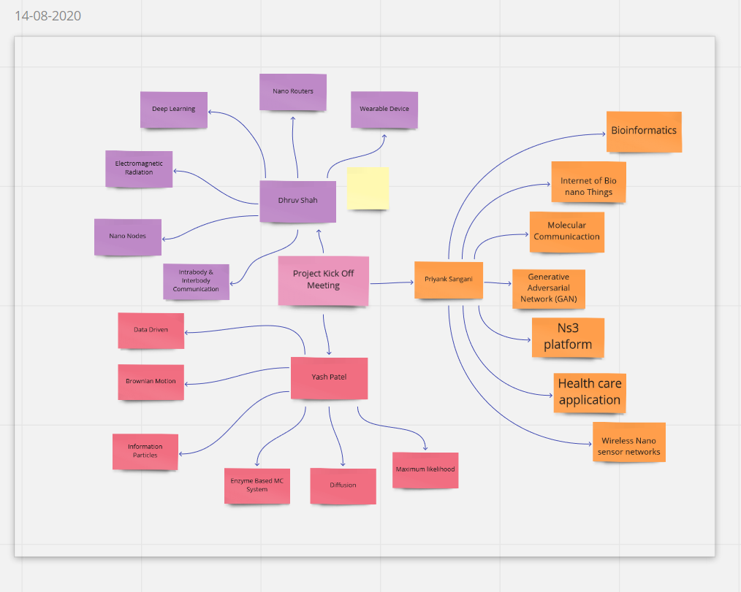
Frame -1

Slide 3
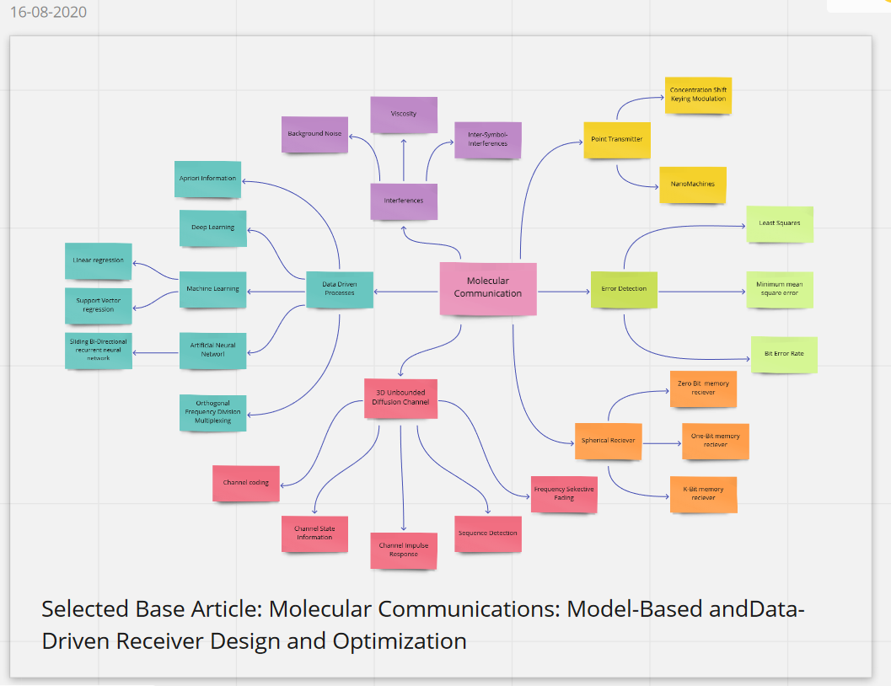
Frame -2

Slide 4
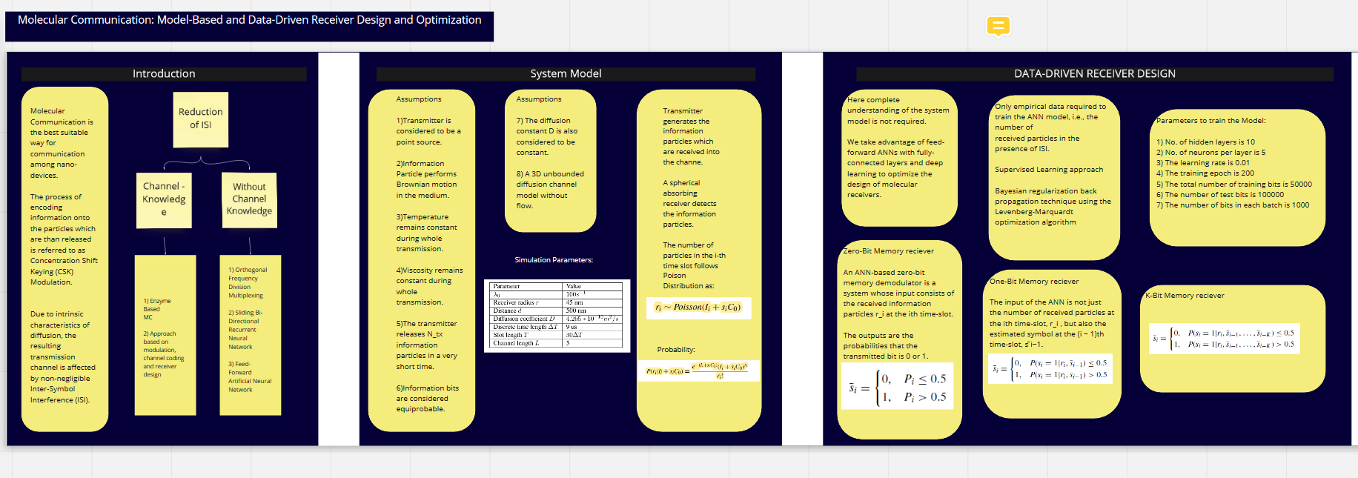
Frame -3 Part 1

Slide 5
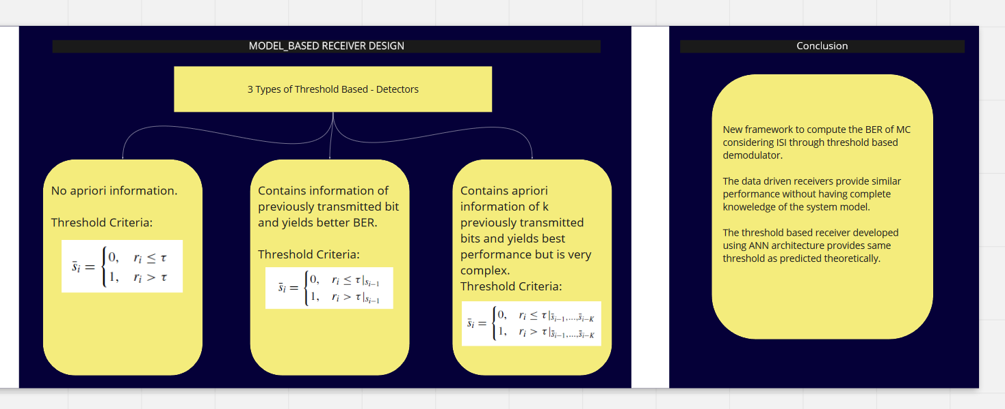
Frame -3 Part 2

Slide 6
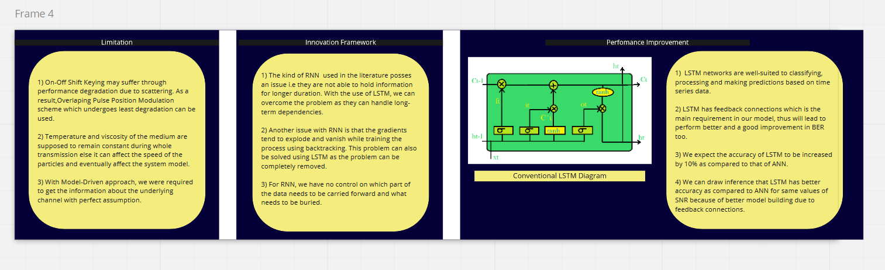
Frame -4

Slide 7
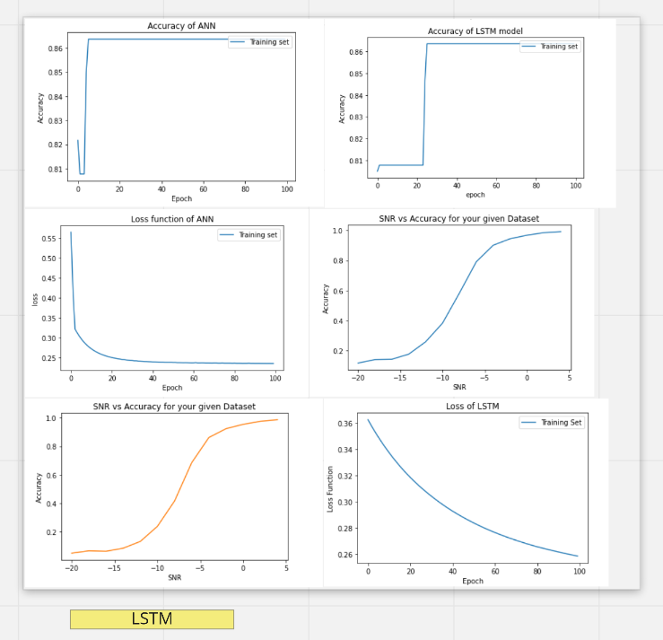
Frame of Graphs

